Slide 1
MongoDB
Data Types
By Arjun Raj

Slide 2
MongoDB Operators
CDate
ObjectId
NumberLong
NumberInt
NumberDecimal

Slide 3
Check Types in the mongo Shell
instanceof
typeof

Slide 4
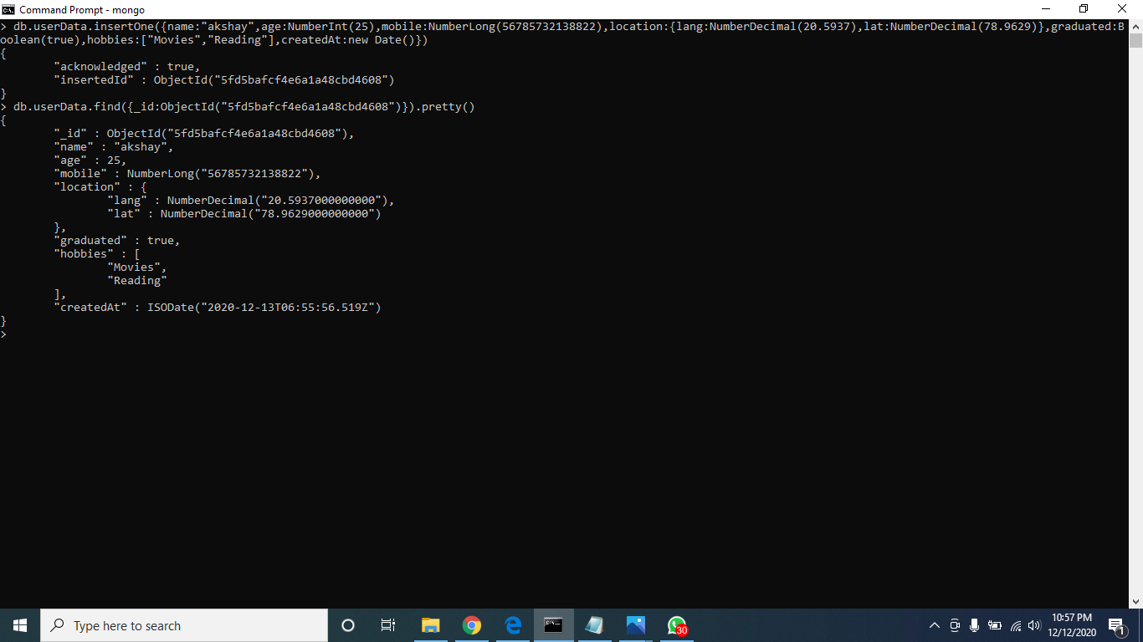
Data types

Slide 5
Thank You!

